Slide 1
Cloud and Integration
Solutions

Slide 2
OPTIMIZE DIGITAL PAYMENTS WITH CLOUD AND INTEGRATION SOLUTIONS
We at Fineotech, aim to transform mobile devices and gadgets into digital eWallets by enabling them with cloud based solutions and integrations with third party apps. This offers your customers a full suite of capabilities by escalating the level of technological convenience.
Cloud based mobile payment solutions are simplifying the process by offering the mobile payment provider to stay in the middle of the transaction and also ensuring security. Beat your competitors with cloud based solutions that are easy and secure for cross-industry solutions.
KNOW MORE FROM OUR EXPERTS

Slide 3
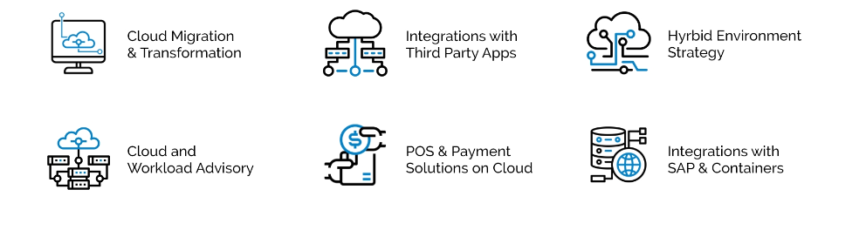
SOLUTIONS IN CLOUD AND INTEGRATION

Slide 4
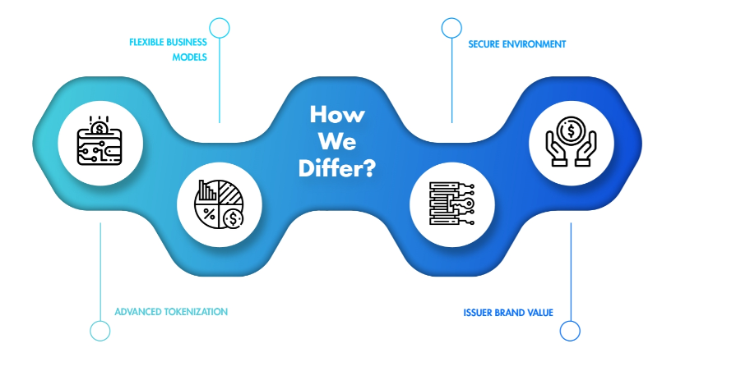

Slide 5
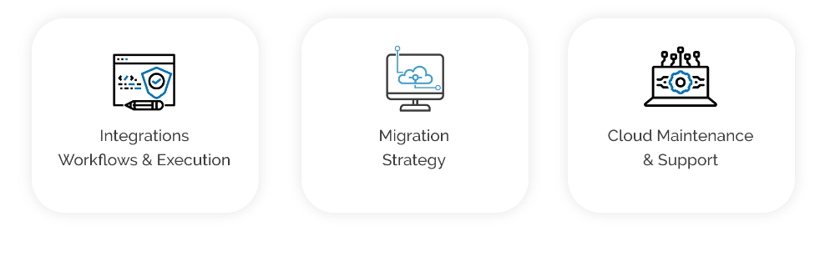
CLOUD AND INTEGRATION SERVICES
We have the experience and expertise to enable amalgamation of key business processes with technology for enhanced security, efficiency and agility.

Slide 6
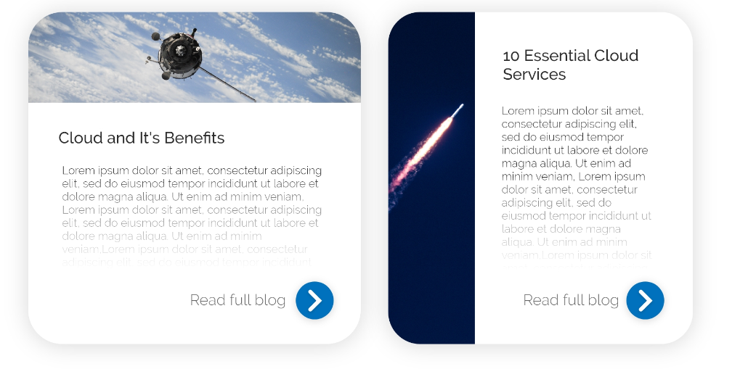
OUR BLOG
Get the latest news and insights as Cloud and Integrations Solutions reshape the payment trends for businesses.

Slide 7
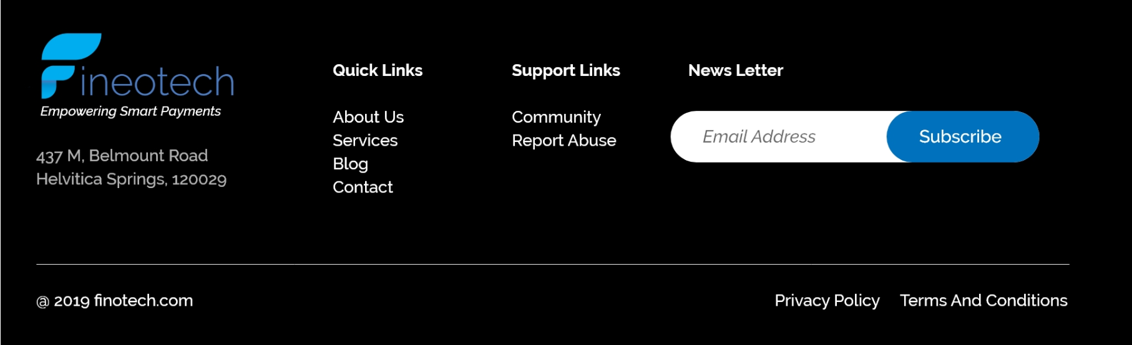
Footer

